Slide 1
Digital Portfolio
STUDENT NAME : Noorul Nasuha
REGISTER NO AND NMID: 469DEE77983202694864AE58BFAC29A7
DEPARTMENT : Bachelor of computer
Application, II Year
COLLEGE/UNIVERSITY : shree Ragavendra
Arts and science College
Annamalai university.

Slide 2
PROJECT TITTLE
DIGITAL PORTFOLIO :
•A Digital Portfolio is a personal website that displays an individual’s skills, education, project and achievement in a wellorganized and attractive format.
•It is designed using HTML,CSS and optionally Javascript to create a simple and responsive layout

Slide 3
Agenda
1.Problem Statement
2.Project Overview
3.End Users
4.Tools and Technologies
5.Portfolio design and Layout
6.Features and Functionality
7.Results and Screenshots
8.Conclusion
9.Github Link

Slide 4
Problem statement
This website solves the problem of static resumes by providing a simple and digital portfolio. It helps students showcase their profile, skills, and education in an interactive way, making it easy to update, share, and connect for career opportunities.
The website should:
•Provide smooth navigation across sections like Home, About, Skills,
•Education, and Contact.
•Present information clearly with an attractive layout.
•Work on both mobile and desktop devices.

Slide 5
Project overview
Project Overview - Digital PortfolioWebsite
Project tittle : Personal Digital Portfolio – Aashika Tholkappiyan (BCA Student)
Ojective:
To design and develop a simple, unique, and responsive portfolio website for a BCСА student to showcase academic details, skills, and career goals with features like profile photo upload, LinkedIn integration, and contact form.

Slide 6
Project overview
3. Key features:
1.Navigation Bar - Links to Home, About,Skills, Education, and Contact sections.
2.Hero Section - Profile photo upload &preview, name, course, location, and LinkedIn button.
3. About Section-Overview of interests, goals, and education focus.
4.Skills Section - Highlights programming knowledge in Python, C++, and C.
5.Education Section - Academic details and learning highlights.
6.Contact Form - Allows visitors to get in touch via email.

Slide 7
Project Overview
4. Technologies used :
• HTML5 - Website structure.
•CSS3 - Styling and layout design
•JavaScript - Interactivity (photo preview, menu toggle, contact form).
•Font Awesome Icons for better visual appeal.
5. Expected Outcomes :
• A professional-looking portfolio website that showcases academic background, technical skills, and career goals.
•It helps in internships, job applications, and professional networking by acting as a digital resume.

Slide 8
Who are the end users?
1. Potential Employees/Recruiters :
To review student's skills, education, and goals.For internship and job opportunities.
2. College faculty / Academic Evaluators :
To assess the project work, presentation, and technical knowledge of the student.For academic grading and evaluation.
3. Students / Peers :
Fellow students who may learn, get inspired, or collaborate.Useful for peer networking and project sharing.
4. Professional connection (LinkedIn and Industry experts) :
To connect with the student for career guidance, mentoring, and opportunities.Helps in building a digital identity.
5. General Visitors :
Anyone interested in knowing the student's background, portfolio, and achievements.Acts as a personal branding tool for wider visibility.

Slide 9
Tools and Techniques
Tools used :
•HTML5 – For creating structure and content.
•CSS3 - For styling and layout design
•Javascript - For interactivity (menus, buttons, forms).
•code Editor (VS Code / CodePen) – For writing and editing code
•web browers (Chrome) - For testing and running the site.

Slide 10
Tools and Techniques
Techniques Used :
• Responsive web design (RWD) - Works on mobile, tablet, and desktop
• Navigation Bar design - Easy movement between sections.
• section-based layout - Divides siteinto About, Skills, and Contact
•Form Handling - Collects user input through forms.
•External Libraries - Font Awesome for icons.

Slide 11
Portfolio Design and Layouts
Design :
•Minimal and professional look - Clean and simple interface.
•Iconic and visual – For better clarity and attraction
•soft colour scheme – Background easy on eyes.
•Readable Typography - Clear headings + neat text.
•Consistent Layouts - Same style followed in all sections.
•User-friendly interface - Easy navigation and smooth flow.

Slide 12
Portfolio Design and Layouts
layouts :
• Header / Navigation Bar - Menu for Home, About, Skills, Contact
• Hero Section - Profile photo, name, and short intro.
•About section - Personal details and goals.
•skills section - List of technical skills.
•Contact Section - Email, LinkedIn, or form.
•Footer - Copyright / small info.

Slide 13
Features and Functionality
Features :
•Responsive Design - Works smoothly on desktop, tablet, and mobile.
•Navigation Bar - Quick access to Home, About, Skills, and Contact.
•Hero Section - Displays name, title, and profile image clearly.
•Interactive Buttons - LinkedIn and contact open directly.
•Font Awesome Icons - Clear visual representation
•Contact Form - Easy to send messages.
•Footer Section - Shows copyright and brief info.

Slide 14
Features and Functionality
Functionality :
•Smooth Scrolling - Easy movement between sections.
•Clickable Social Media Links - DirectLinkedIn integration.
•Form Submission - Collects visitor messages
•Mobile-Friendly Layouts - Proper alignment on all devices.
•Live Preview of Profile – Instantly shows uploaded details (unique point.
•Minimal user steps – Simple navigation without confusion (unique point).

Slide 15
Results and Screen shots
Results :
•A fully functional personal digital portfolio website was Created.
•Showcases profile, education, skills, and contact information in an interactive layout.
•Responsive design works seamlessly on desktop and Mobile devices.
•Provides easy navigation and direct LinkedIn integration.

Slide 16
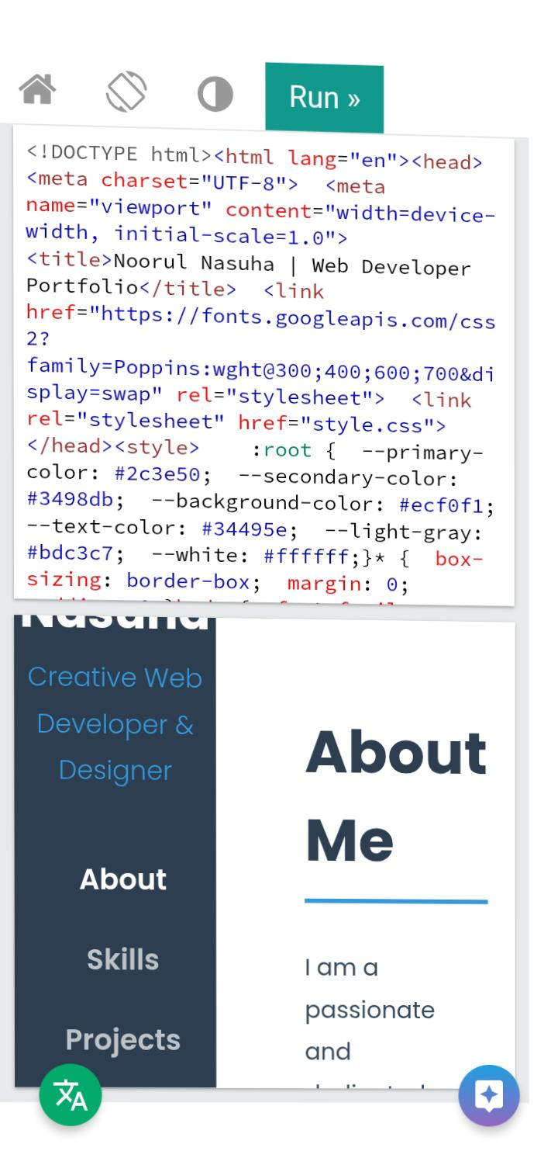
Screenshots

Slide 17
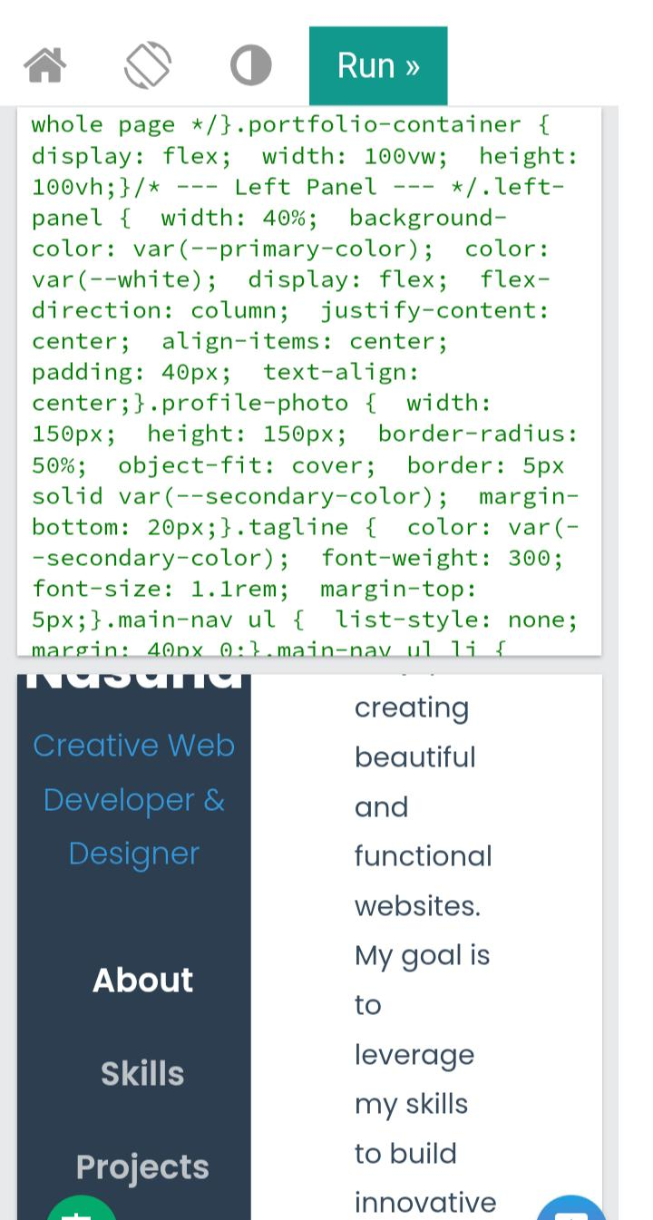
Screenshot

Slide 18
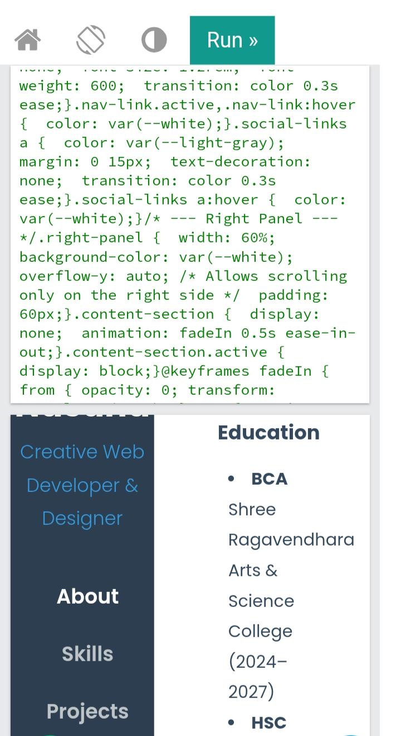
Screenshots

Slide 19
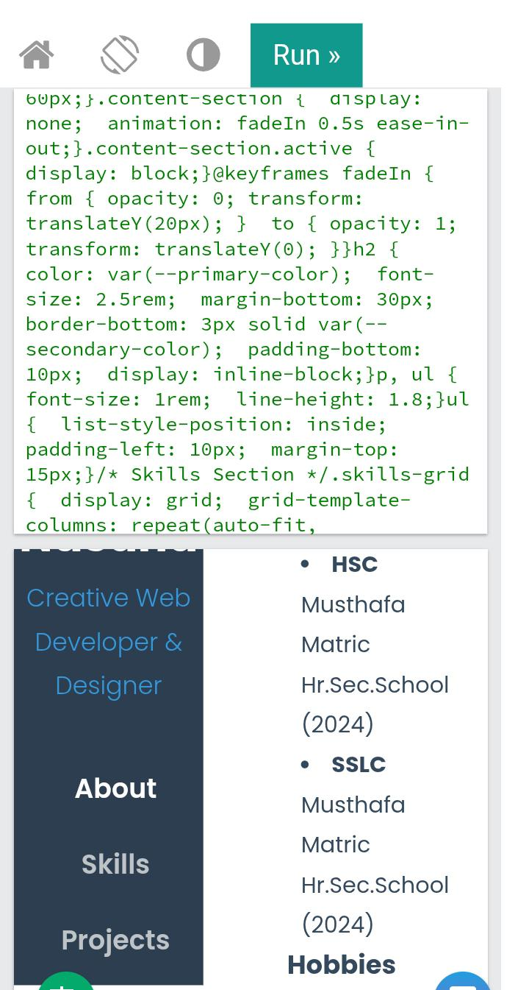
Screenshots

Slide 20
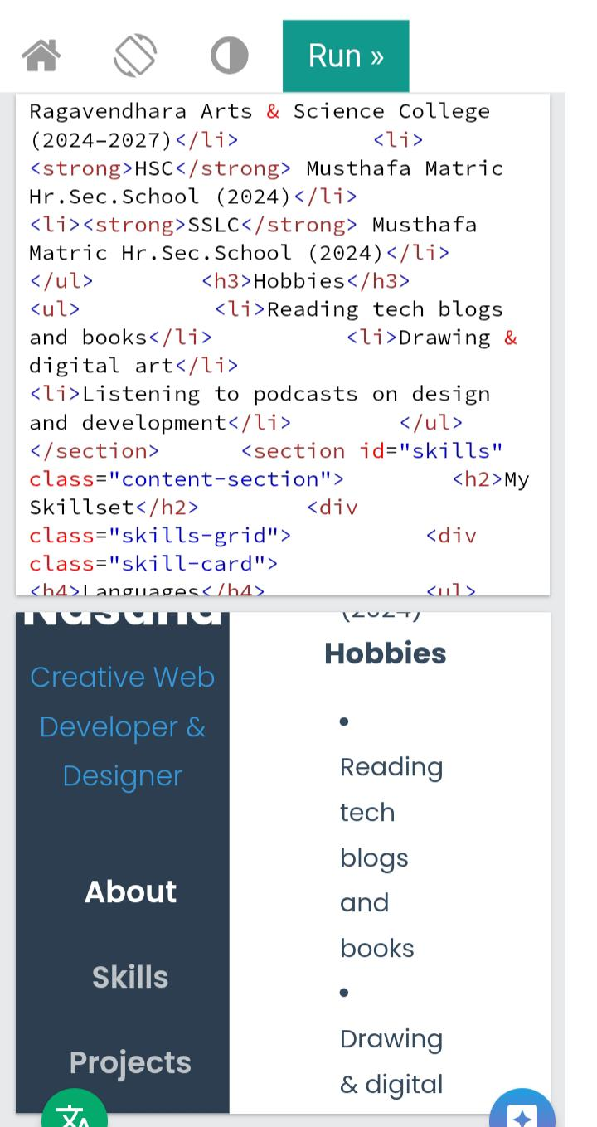
Screenshot

Slide 21
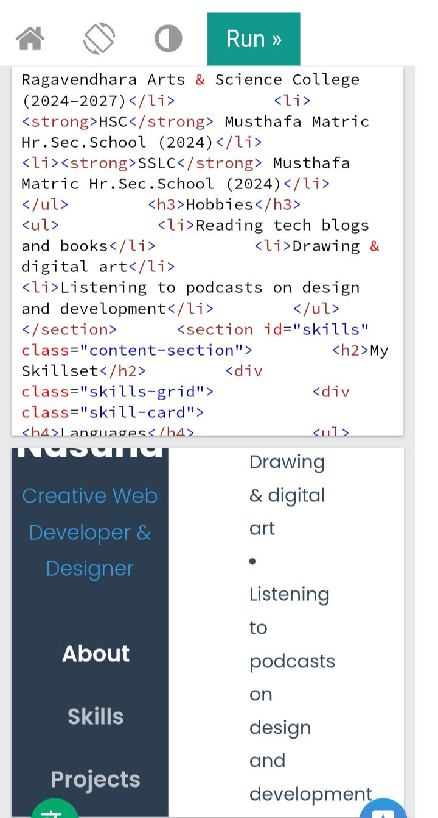
Screenshot

Slide 22
